Slide 1
Fictional Apparel's Advertising Strategy
Avinash Bisram, Dave Thomas, Evan Tuakosen-Ampah BUA 631 Project 1

Slide 2
Problem Statement
Fictional Apparel is a company that produces clothing that appeals to all ages. It has decided to start a social-media advertising campaign to drive more traffic to its website, showcasing its new seasonal releases. They are considering advertising on TikTok, Instagram, X, YouTube, and Facebook. They also believe their customer base can generally be divided into mutually exclusive groups based on sex and age. Each advertisement is expected to reach a certain number of people ("exposures") depending on the customer group and advertising platform. Furthermore, each platform has a different "cost-per-mile," a rate charged for each person who views an ad. A consulting company has provided Fictional Apparel with estimated figures on how likely a person viewing an advertisement will later visit the company's website (depending on customer group and platform). The marketing team has also outlined benchmark values for the number of exposures they would like to reach for each customer group and minimum/maximum required advertisements for each platform based on current industry trends. If Fictional Apparel has a budget of 2 million dollars to utilize in this campaign, how many advertisements should they show on each platform to maximize traffic to their website while also satisfying the benchmarks provided by the marketing team?

Slide 3
Objective and Parameters
Objective: MAXIMIZE total website visits of campaign
Decision Variables: Number of ads to purchase on each of the 5 platforms (TikTok, Instagram, X, YouTube, Facebook)
Inputs
Expected Exposures per advertisement (5 platforms and 8 customer-groups)
Likelihood of website traffic per Exposure (5 platforms and 8 customer-groups)
Cost per Exposure (Cost-per-mile rate of each platform)
Required Exposures for each Customer Group
Minimum and Maximum values for ads to purchase on each platform
Allocated Budget for entire campaign

Slide 4
Constraints
Maximum Budget: The total cost of advertisements cannot exceed budget of 2 million dollars
Non-negativity of ads: Number of ads purchased on each platform cannot be negative.
Integer Constraint: Number of ads purchased on each platform must be integer values.
Required Exposures: Total number of exposures for each customer-group must be at least the required amounts.
Minimum/Maximum Ads Purchased: The number of ads purchased for each platform must be between the range of minimum and maximum benchmark values (inclusive).
Note: Exact values can be seen in the Spreadsheet Model.

Slide 5
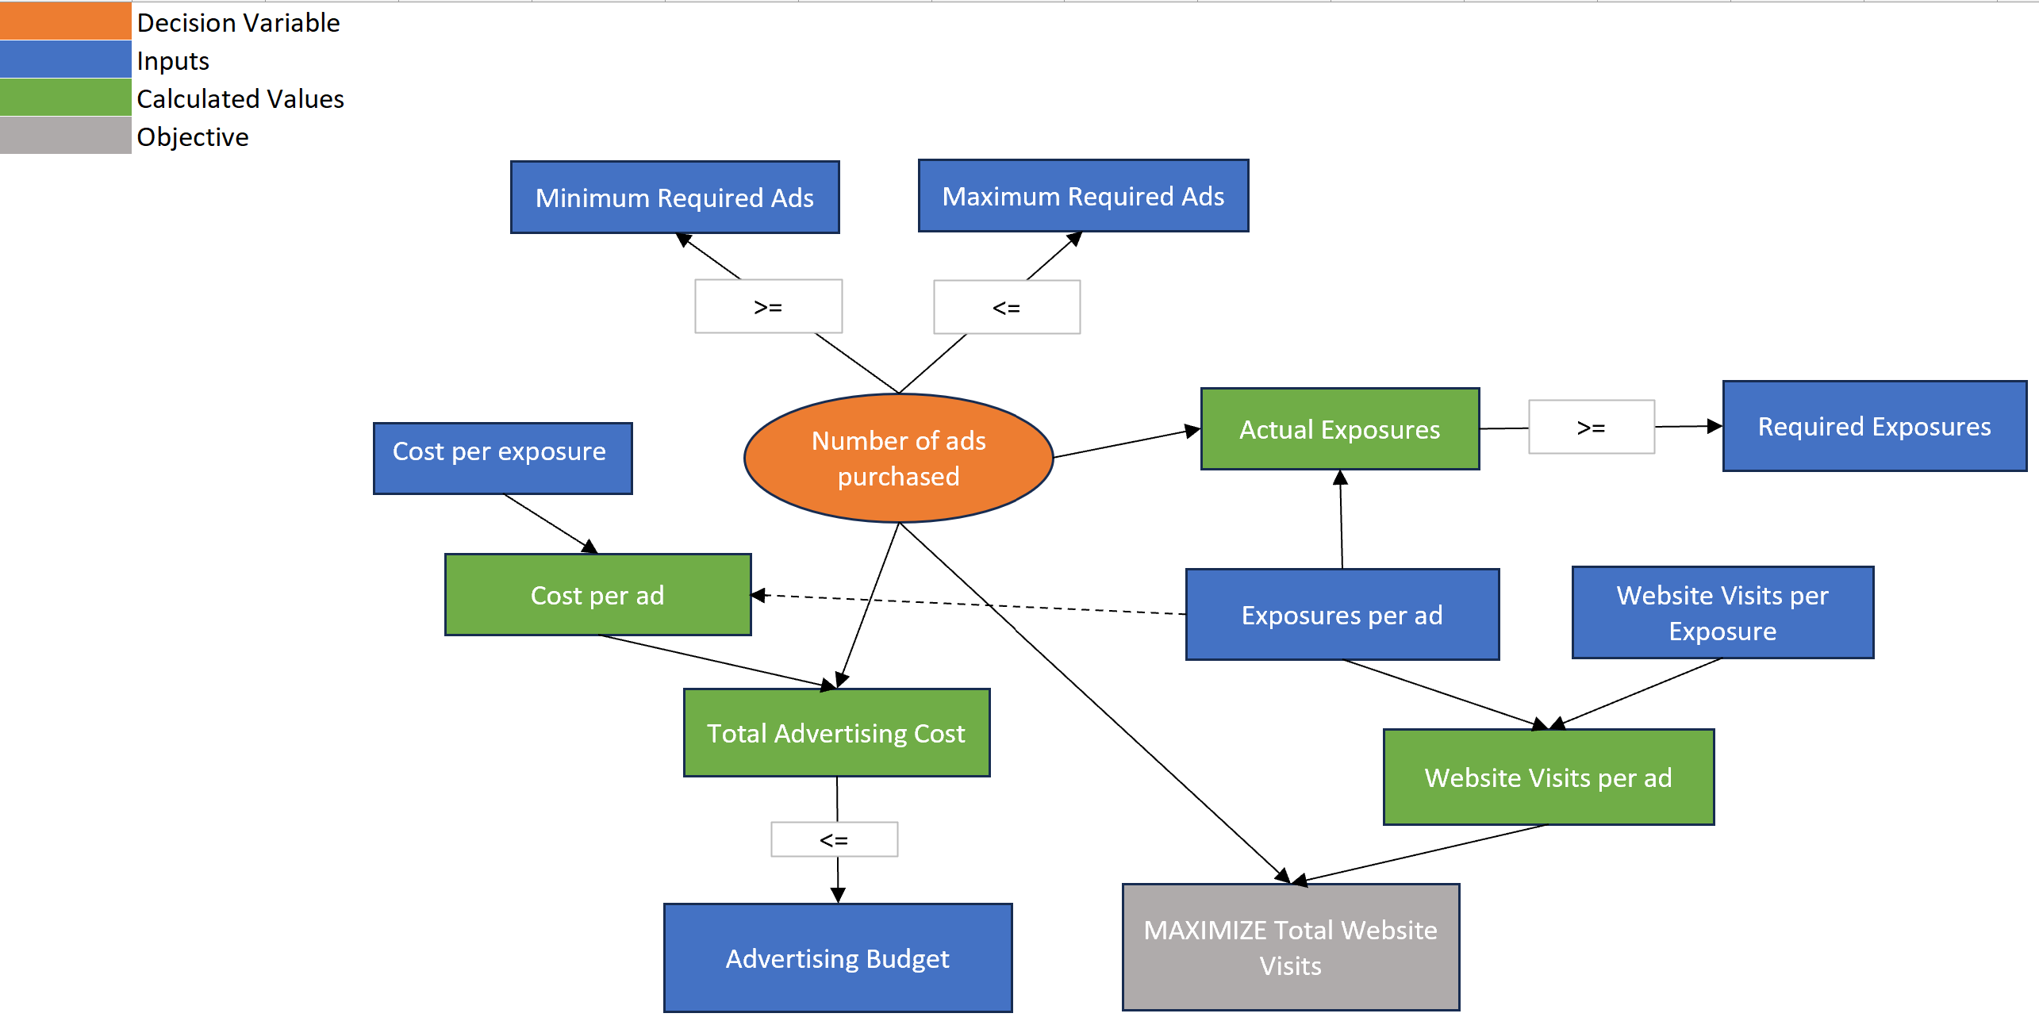
Big Picture Diagram

Slide 6
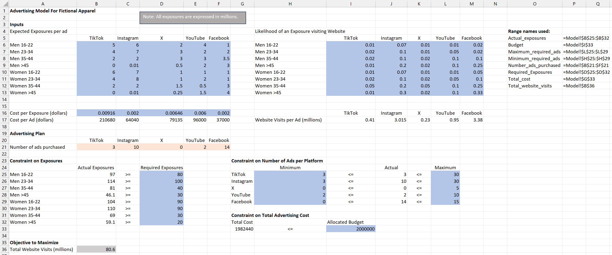
Spreadsheet Model

Slide 7
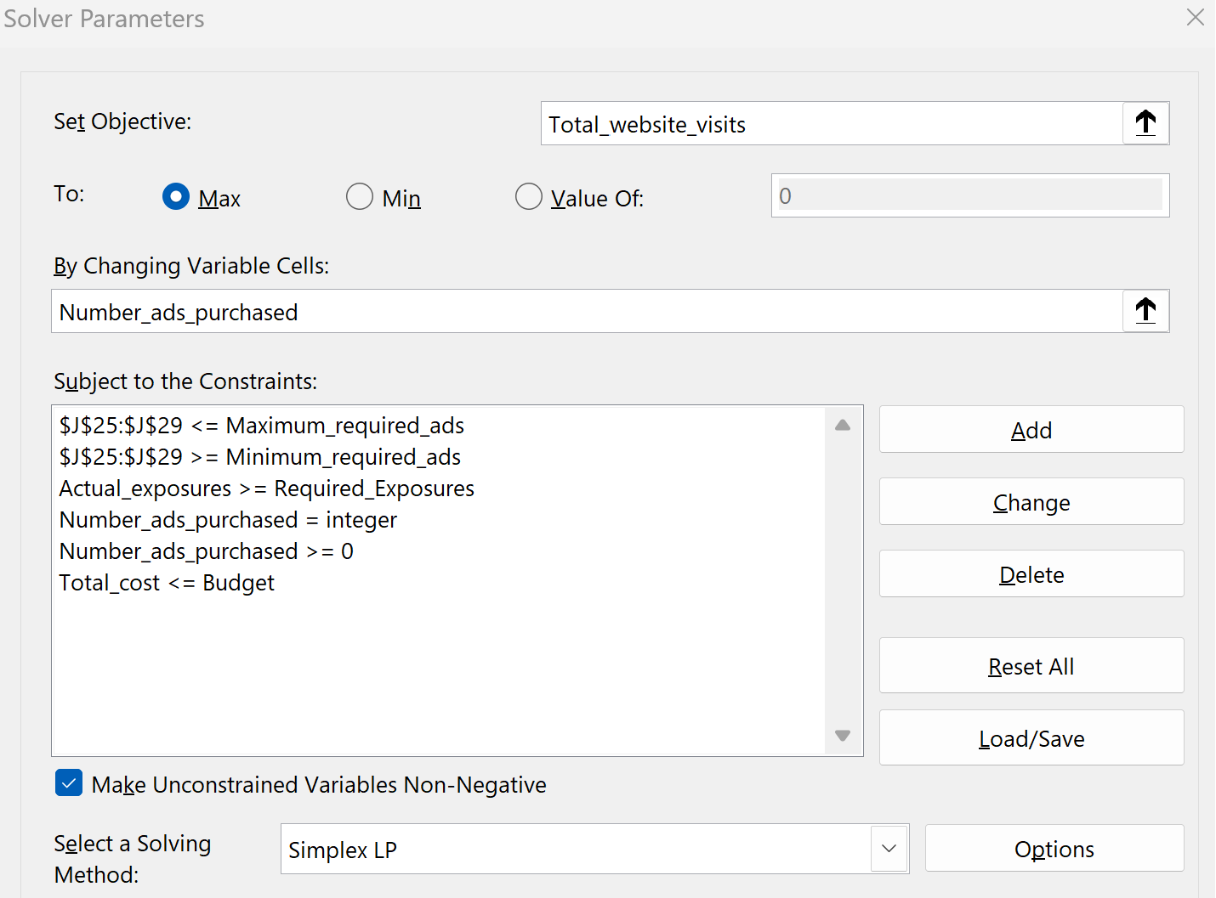
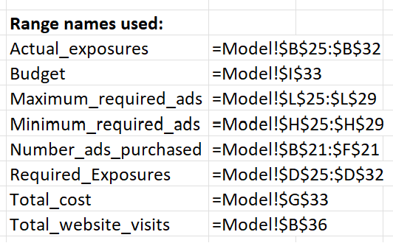
Solver Solution

Slide 8
Optimal Solution and Binding Variables
Optimal Solution: Number of Ads to purchase on each Platform
TikTok: 3
Instagram: 10
X: 0
YouTube: 2
Facebook: 14
Maximum Objective: 80.6 million website visits
Binding Variables:
Number of ads purchased for TikTok, X, and YouTube are all equivalent to their MINIMUM required values of 3, 0, and 2 respectively.
No binding variables related to required exposures constraint (all customer groups exceeded their minimum required exposures).

Slide 9
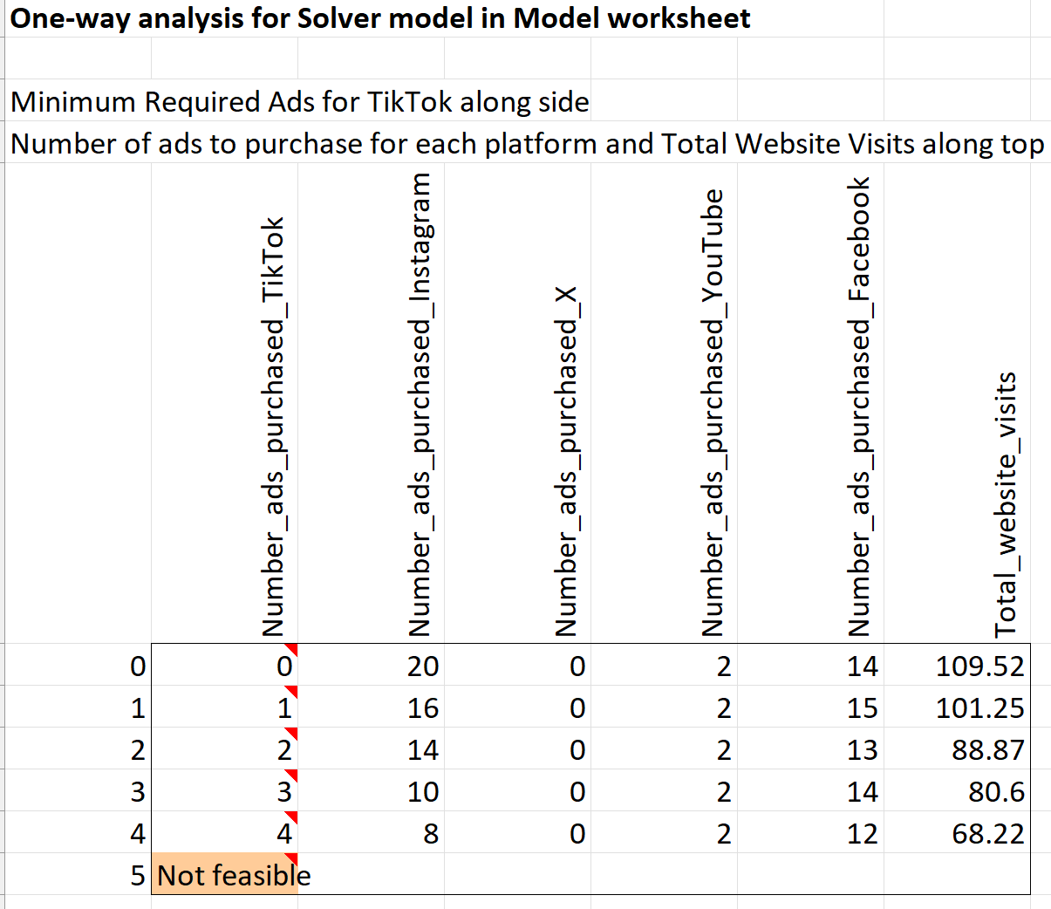
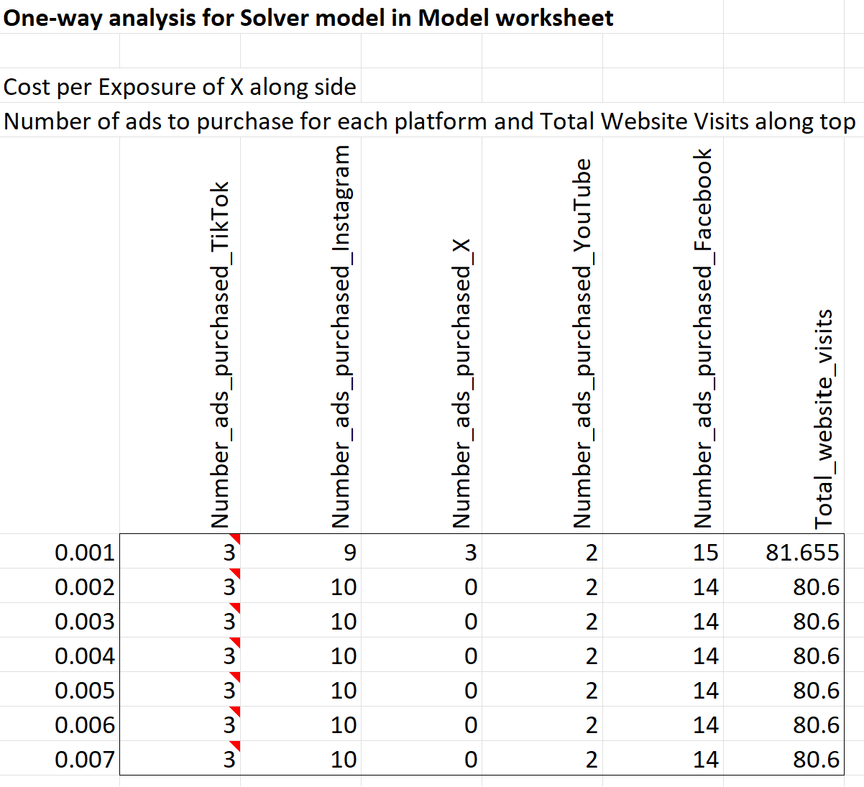
Sensitivity Analysis

Slide 10
Concluding Insights
TikTok, Instagram, and X have higher overall exposures per customer group, but the optimal solution favored Facebook and Instagram due to higher overall conversion rates from exposures to website visits. X had the lowest conversion rate for website traffic, which explains why the optimal solution purchased NO ads on the platform.
To increase website visits further, Fictional Apparel should consider decreasing the minimum constraint on ads purchased for TikTok as much as possible.
The cost-per-exposure would have to be drastically decreased to make purchasing ads on X viable with the current constraints. If the company wants to advertise on the platform, it should consider taking steps to increase the likelihood of converting exposures to website traffic instead.

